Slide 1
Gas laws
Chapter: 8.3

Slide 2
When a balloon is heated, it gets bigger, thus maintaining a constant pressure. If a sealed container is exposed to extreme heat, such as that from a fire, the gas pressure can build up and the container may explode.
To compare the changes in conditions that involve gases, scientists use a set of standard conditions for temperature and pressure.

Slide 3
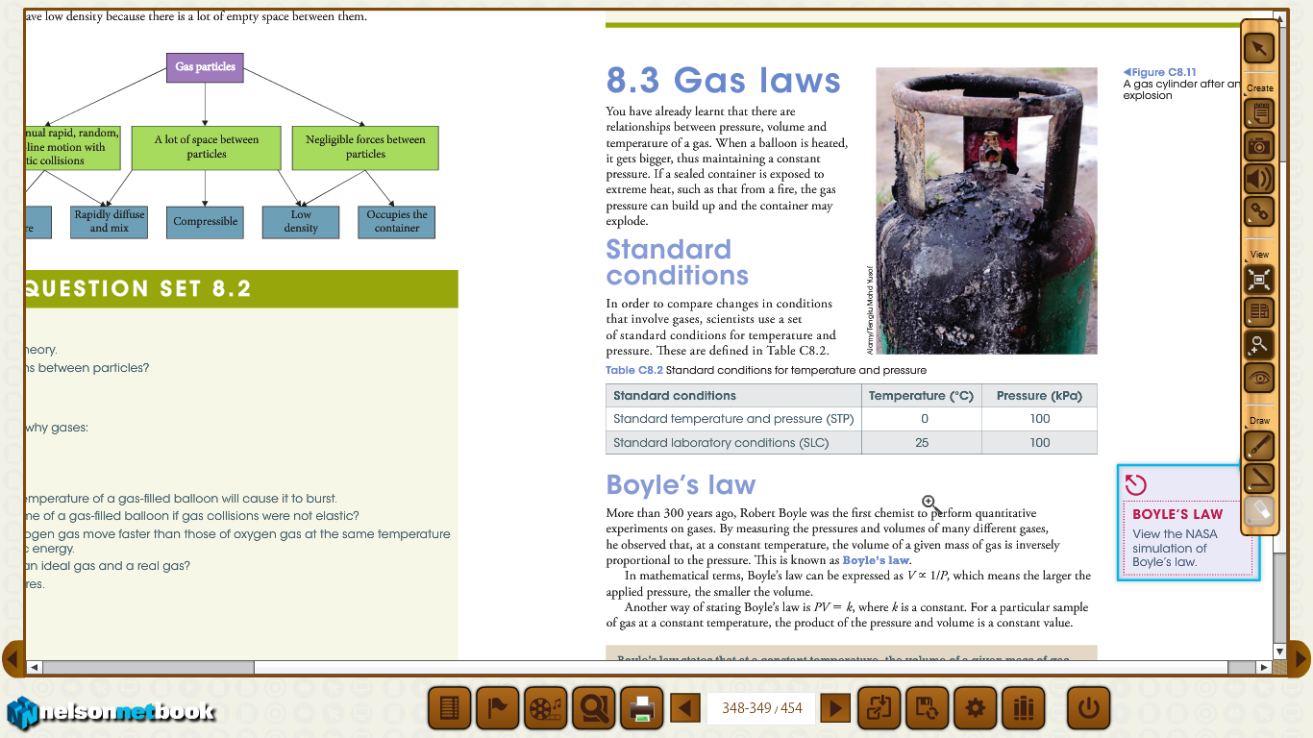

Slide 4

Boyle’s law
More than 300 years ago, Robert Boyle was the first chemist to perform quantitative experiments on gases.
Boyle’s law states that at a constant temperature, the volume of a given mass of gas is inversely proportional to the applied pressure.
Boyle’s law can be expressed as
This means the larger the applied pressure, the smaller the volume.

Slide 5
An alternative form of Boyle’s law is :
P1V1= P2V2
Where P1 and P2 are the initial and final pressures V1 and V2 are the initial and final volumes.
See worked example: 8.1 from page: 350

Slide 6
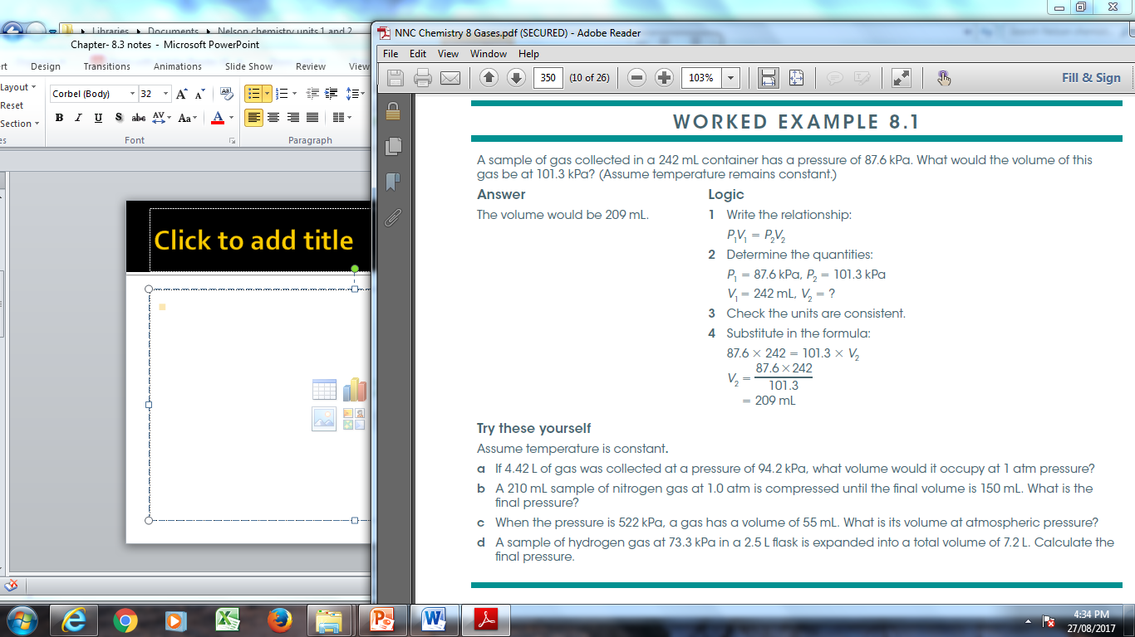

Slide 7
Another way of expressing Boyle’s law is
PV= k where k- is a constant.
For a particular sample of gas at a given temperature, the product of the pressure and volume is a constant value.

Slide 8
Charles’ law
About 100 years after Boyle investigated the relationship between pressure and volume, French physicist Jacques Charles studied the relationship between temperature and volume using gases.
For a fixed quantity of gas at a constant pressure, the volume increases linearly with temperature. This relationship is called Charles’ law.

Slide 9
When experimental temperature and volume data are plotted, a linear relationship emerges, as in Figure C8. 13.

Slide 10
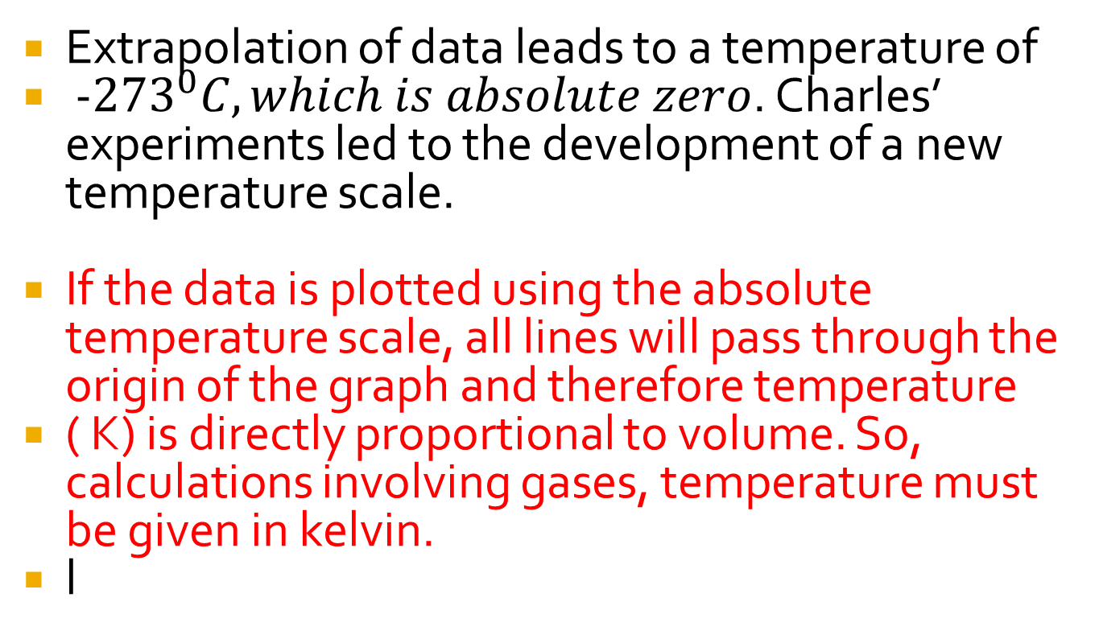
Extrapolation of data leads to a temperature of
-${273}^{0}C, which is absolute zero$. Charles’ experiments led to the development of a new temperature scale.
If the data is plotted using the absolute temperature scale, all lines will pass through the origin of the graph and therefore temperature
( K) is directly proportional to volume. So, calculations involving gases, temperature must be given in kelvin.
l

Slide 11
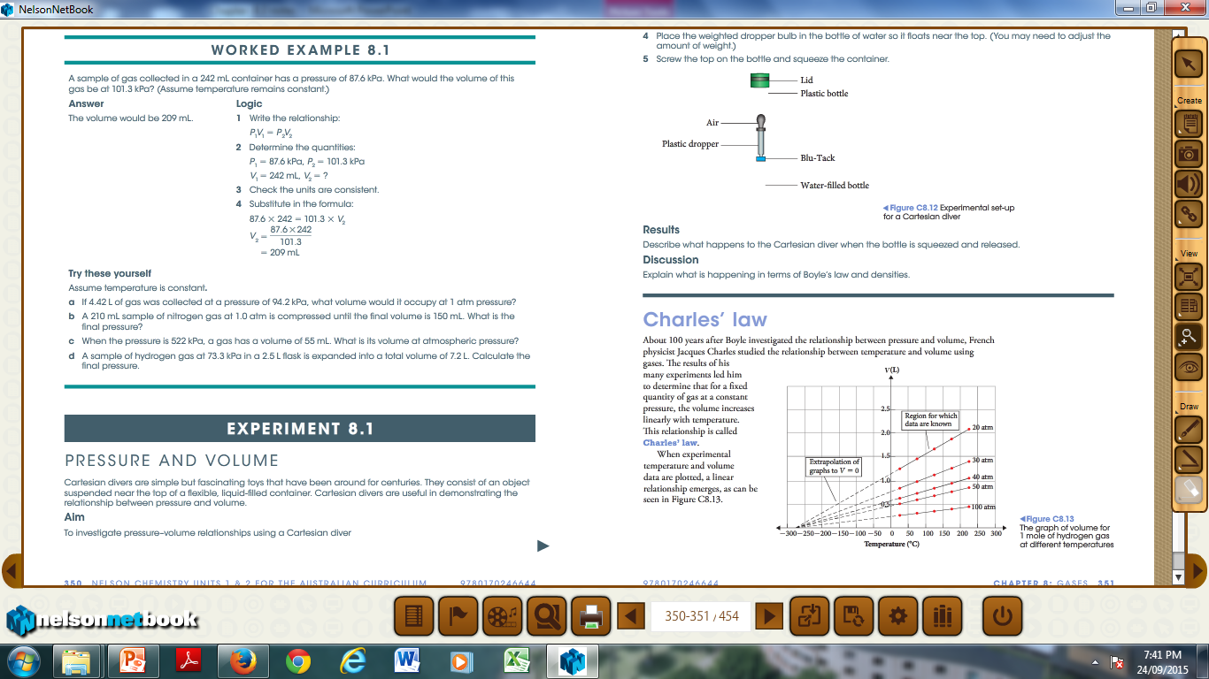

Slide 12
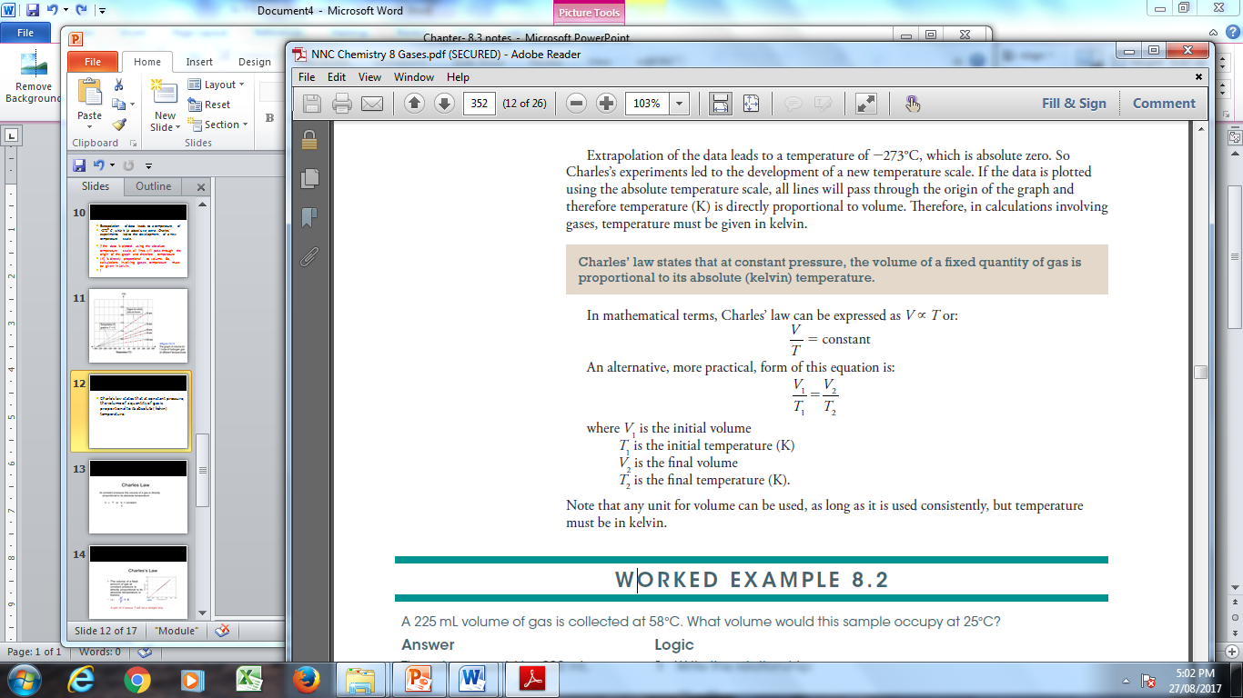
Charle’s law states that at constant pressure, the volume of a quantity of gas is proportional to its absolute ( kelvin) temperature.

Slide 13
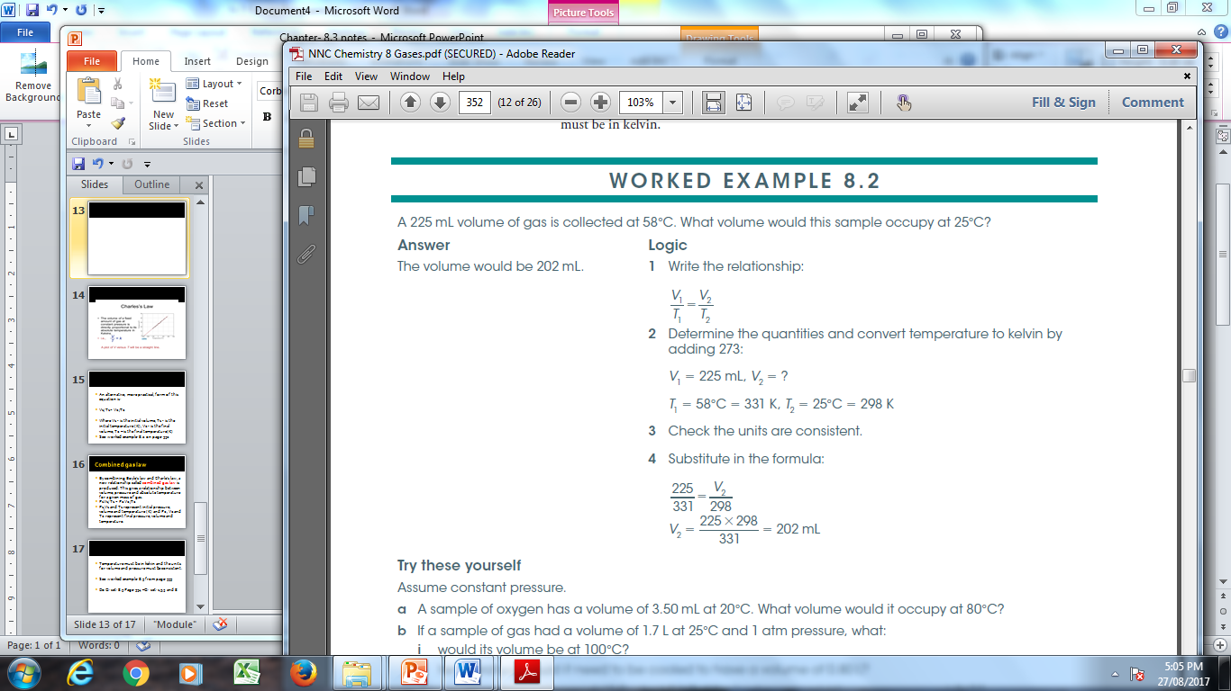

Slide 14
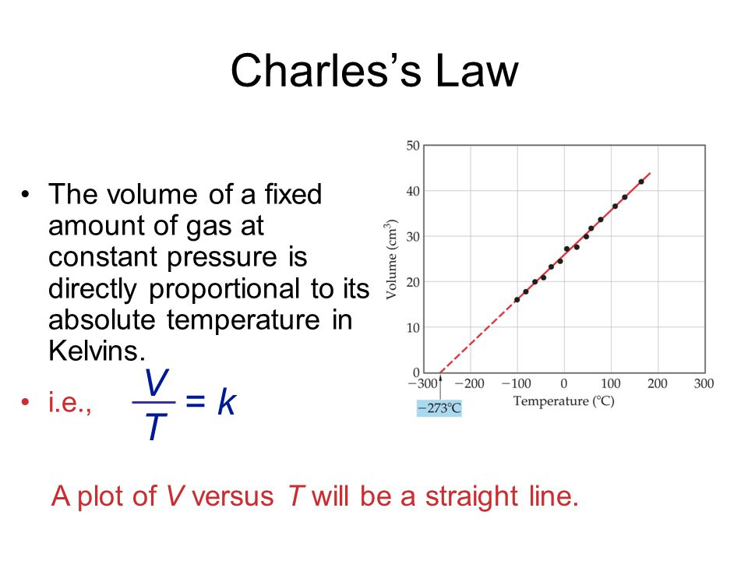

Slide 15
Combined gas law
By combining Boyle’s law and Charles’ law, a new relationship called combined gas law is produced. This gives a relationship between volume, pressure and absolute temperature for a given mass of gas.
P1V1/ T1 = P2V2/T2
P1,V1 and T1 represent initial pressure, volume and temperature (K) and P2, V2 and T2 represent final pressure, volume and temperature (K) .

Slide 16
Temperature must be in kelvin and the units for volume and pressure must be consistent.
Do Q: set: 8.3 Page: 354 –Q: set: 1,3,5 and 8

Slide 17
